Slide 1
A Multiple State Model for Disability Using the Decomposition of Death Probabilities and Cross-Sectional Data
傅鈺婷
指導教授：戴天時 教授
論文作者：IRENE ALBARRAN, MERCEDES AYUSO,
MONTSERRAT GUILLÉN, AND MALENA MONTEVERDE

Slide 2
Data
盛行率(prevalence rate)
死亡率(mortality rate)

Slide 3

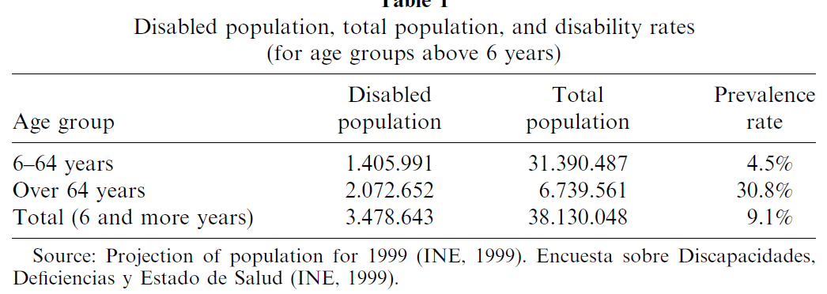
Data
盛行率(prevalence rate)
死亡率(mortality rate)

Slide 4
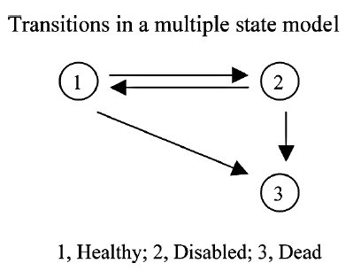
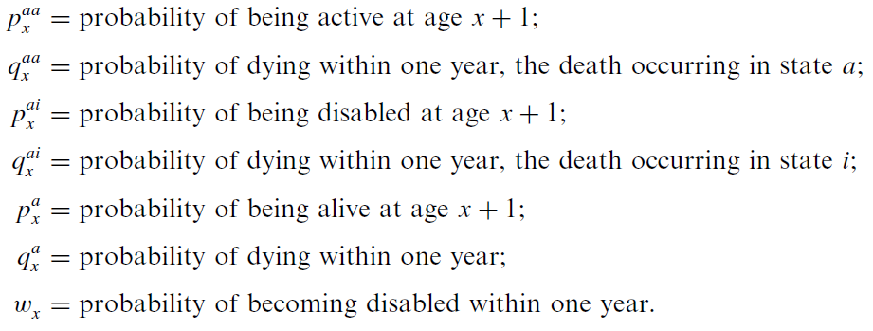
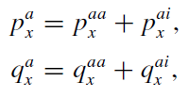
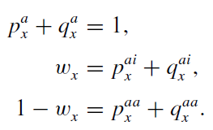
Notation
在 x 歲下為存活者

Slide 5
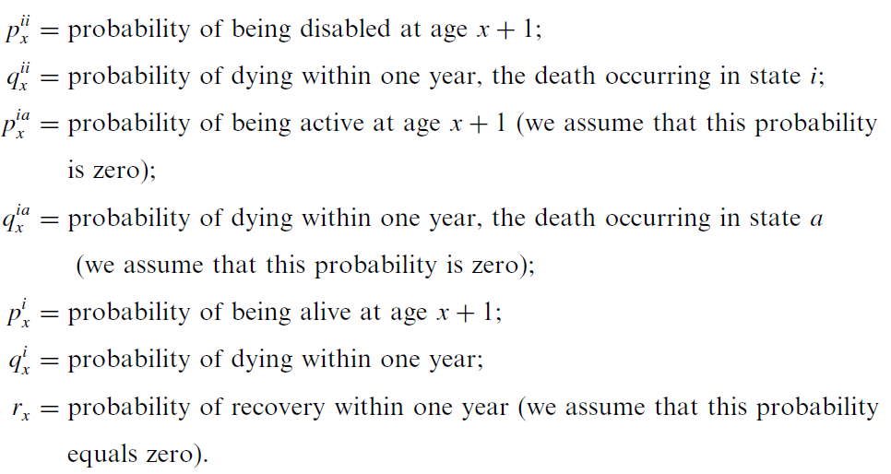
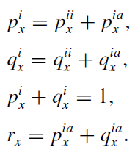

Notation
在 x 歲下為長照需求者

Slide 6
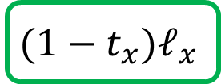

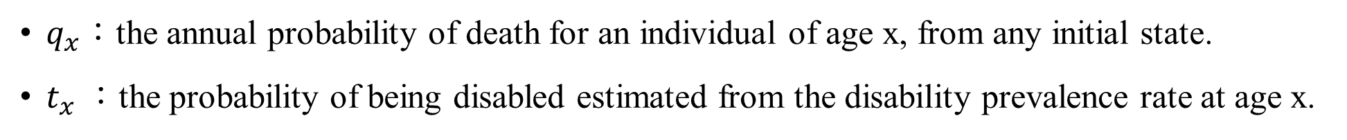

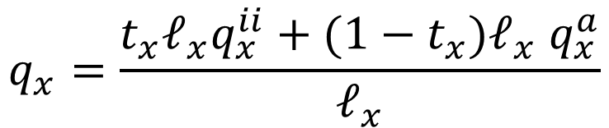


Survival and Transition Probabilities
針對各狀態到死亡的機率
$q_{x}$：the annual probability of death for an individual of age x, from any initial state.
$t_{x}$：the probability of being disabled estimated from the disability prevalence rate at age x.
$$q_{x}=\left(1−t_{x}\right)q_{x}^{a}+t_{x}q_{x}^{ii}=\left(1−t_{x}\right)(q_{x}^{aa}+q_{x}^{ai})+t_{x}q_{x}^{ii}$$
$$=\left(1−t_{x}\right)q_{x}^{aa}+\left(1−t_{x}\right)q_{x}^{ai}+t_{x}q_{x}^{ii}$$
$$p_{x}=\left(1−t_{x}\right)p_{x}^{aa}+\left(1−t_{x}\right)p_{x}^{ai}+t_{x}p_{x}^{ii}$$
長照需求
$$t_{x}ℓ_{x}$$
$$q_{x}^{ii}$$
$$ℓ_{x}$$
$$q_{x}=\frac{t_{x}ℓ_{x}q_{x}^{ii}+(1−t_{x})ℓ_{x} q_{x}^{a}}{ℓ_{x}}$$
健康
$$(1−t_{x})ℓ_{x}$$
$$q_{x}^{a}$$

Slide 7


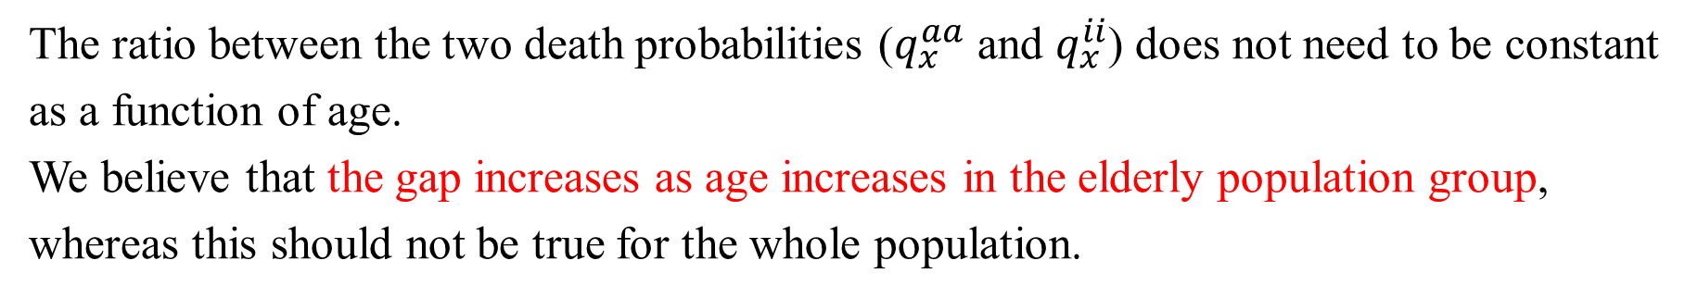




Survival and Transition Probabilities
假設1
$$w_{x}$$
先轉換成長照需求者，再乘以長照需求者的死亡率
在均勻分配假設下，$k_{1}=1/2$
$$x$$
$$x+1$$
假設2
The ratio between the two death probabilities ($q_{x}^{aa}$ and $q_{x}^{ii}$) does not need to be constant as a function of age.
We believe that the gap increases as age increases in the elderly population group, whereas this should not be true for the whole population.

Slide 8
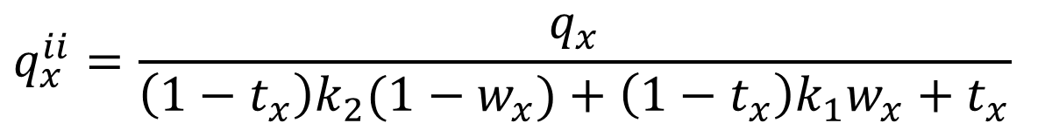
Survival and Transition Probabilities
假設1
假設1、假設2代入原式
假設2
$$q_{x}=\left(1−t_{x}\right)q_{x}^{aa}+\left(1−t_{x}\right)q_{x}^{ai}+t_{x}q_{x}^{ii}$$
代入
$$=\left(1−t_{x}\right)k_{2}(1−w_{x})q_{x}^{ii}+\left(1−t_{x}\right)k_{1}w_{x}q_{x}^{ii}+t_{x}q_{x}^{ii}$$
$$q_{x}^{ii}=\frac{q_{x}}{\left(1−t_{x}\right)k_{2}(1−w_{x})+\left(1−t_{x}\right)k_{1}w_{x}+t_{x}}$$

Slide 9






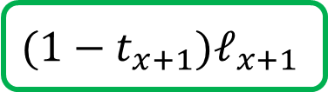
Survival and Transition Probabilities
長照需求
$$t_{x+1}ℓ_{x+1}$$
$$q_{x+1}^{ii}$$
針對健康狀態到長照需求狀態的機率
$$ℓ_{x+1}$$
健康
$$ℓ_{x}\left(1−q_{x}\right)t_{x+1}=ℓ_{x}t_{x}\left(1−q_{x}^{ii}\right)+ℓ_{x}(1−t_{x})(w_{x}−q_{x}^{ai})$$
$$(1−t_{x+1})ℓ_{x+1}$$
$$q_{x+1}^{a}$$
利用此等式求出$w_{x}$
$$ℓ_{x+1}=ℓ_{x}\left(1−q_{x}\right)$$
接著下面要解釋等式含意
架構圖
長照需求
$$t_{x}ℓ_{x}$$
$$q_{x}^{ii}$$
$$ℓ_{x}$$
健康
將使用到的定義
$$(1−t_{x})ℓ_{x}$$
$$q_{x}^{a}$$

Slide 10

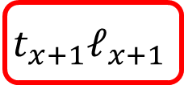
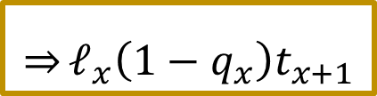
Survival and Transition Probabilities
B
長照需求
$$t_{x+1}ℓ_{x+1}$$
$$q_{x+1}^{ii}$$
針對健康狀態到長照需求狀態的機率
$$ℓ_{x+1}$$
健康
$$ℓ_{x}\left(1−q_{x}\right)t_{x+1}=ℓ_{x}t_{x}\left(1−q_{x}^{ii}\right)+ℓ_{x}(1−t_{x})(w_{x}−q_{x}^{ai})$$
$$(1−t_{x+1})ℓ_{x+1}$$
$$q_{x+1}^{a}$$
1
代入
$$t_{x+1}ℓ_{x+1}$$
$$\underset{⇒}{}ℓ_{x}\left(1−q_{x}\right)t_{x+1}$$
$$ℓ_{x+1}=ℓ_{x}\left(1−q_{x}\right)$$
A
$$ℓ_{x+1}=ℓ_{x}\left(1−q_{x}\right)$$
A
B
1
長照需求
這部分為x+1歲的長照需求人數
$$t_{x}ℓ_{x}$$
$$q_{x}^{ii}$$
$$ℓ_{x}$$
健康
$$(1−t_{x})ℓ_{x}$$
$$q_{x}^{a}$$

Slide 11
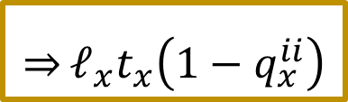


Survival and Transition Probabilities
長照需求
$$t_{x+1}ℓ_{x+1}$$
$$q_{x+1}^{ii}$$
針對健康狀態到長照需求狀態的機率
$$ℓ_{x+1}$$
健康
$$ℓ_{x}\left(1−q_{x}\right)t_{x+1}=ℓ_{x}t_{x}\left(1−q_{x}^{ii}\right)+ℓ_{x}(1−t_{x})(w_{x}−q_{x}^{ai})$$
$$(1−t_{x+1})ℓ_{x+1}$$
$$q_{x+1}^{a}$$
2
乘以
$${(1−q}_{x}^{ii})$$
$$\underset{⇒}{}ℓ_{x}t_{x}\left(1−q_{x}^{ii}\right)$$
$$ℓ_{x+1}=ℓ_{x}\left(1−q_{x}\right)$$
$$t_{x}ℓ_{x}$$
2
長照需求
這部分為x歲為長照需求者到x+1歲還生存的人數
$$t_{x}ℓ_{x}$$
$$q_{x}^{ii}$$
$$ℓ_{x}$$
健康
$$(1−t_{x})ℓ_{x}$$
$$q_{x}^{a}$$

Slide 12
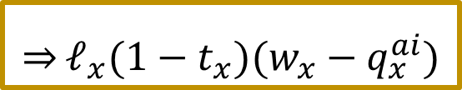


Survival and Transition Probabilities
長照需求
$$t_{x+1}ℓ_{x+1}$$
$$q_{x+1}^{ii}$$
針對健康狀態到長照需求狀態的機率
$$ℓ_{x+1}$$
健康
$$ℓ_{x}\left(1−q_{x}\right)t_{x+1}=ℓ_{x}t_{x}\left(1−q_{x}^{ii}\right)+ℓ_{x}(1−t_{x})(w_{x}−q_{x}^{ai})$$
$$(1−t_{x+1})ℓ_{x+1}$$
$$q_{x+1}^{a}$$
3
A
B
$$\underset{⇒}{}ℓ_{x}(1−t_{x})(w_{x}−q_{x}^{ai})$$
$$(1−t_{x})ℓ_{x}$$
乘以
$${(w_{x}−q}_{x}^{ai})$$
$$ℓ_{x+1}=ℓ_{x}\left(1−q_{x}\right)$$
3
長照需求
這部分為x歲為健康者到x+1歲以長照需求者生存的人數
$$t_{x}ℓ_{x}$$
$$q_{x}^{ii}$$
$$ℓ_{x}$$
A
健康
B
$$(1−t_{x})ℓ_{x}$$
$$q_{x}^{a}$$

Slide 13
Survival and Transition Probabilities
長照需求
$$t_{x+1}ℓ_{x+1}$$
$$q_{x+1}^{ii}$$
針對健康狀態到長照需求狀態的機率
$$ℓ_{x+1}$$
1
2
3
健康
$$ℓ_{x}\left(1−q_{x}\right)t_{x+1}=ℓ_{x}t_{x}\left(1−q_{x}^{ii}\right)+ℓ_{x}(1−t_{x})(w_{x}−q_{x}^{ai})$$
$$(1−t_{x+1})ℓ_{x+1}$$
$$q_{x+1}^{a}$$
1
x+1歲的長照需求人數
2
x歲為長照需求者到x+1歲還生存的人數
$$ℓ_{x+1}=ℓ_{x}\left(1−q_{x}\right)$$
3
x歲為健康者到x+1歲以長照需求者生存的人數
長照需求
$$t_{x}ℓ_{x}$$
$$q_{x}^{ii}$$
$$ℓ_{x}$$
健康
$$(1−t_{x})ℓ_{x}$$
$$q_{x}^{a}$$

Slide 14
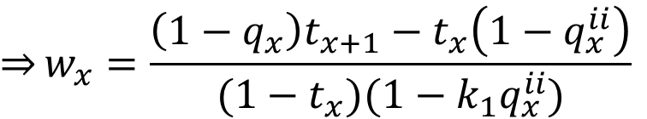
Survival and Transition Probabilities
針對健康狀態到長照需求狀態的機率
$$ℓ_{x}\left(1−q_{x}\right)t_{x+1}=ℓ_{x}t_{x}\left(1−q_{x}^{ii}\right)+ℓ_{x}(1−t_{x})(w_{x}−q_{x}^{ai})$$
$$\left(1−q_{x}\right)t_{x+1}=t_{x}\left(1−q_{x}^{ii}\right)+(1−t_{x})(w_{x}−q_{x}^{ai})$$
假設1
代入
$$\left(1−q_{x}\right)t_{x+1}=t_{x}\left(1−q_{x}^{ii}\right)+(1−t_{x})(w_{x}−k_{1}w_{x}q_{x}^{ii})$$
$$\overset{⇒}{}\left(1−q_{x}\right)t_{x+1}=t_{x}\left(1−q_{x}^{ii}\right)+(1−t_{x})(1−k_{1}q_{x}^{ii})w_{x}$$
$$\overset{⇒}{}w_{x}=\frac{\left(1−q_{x}\right)t_{x+1}−t_{x}\left(1−q_{x}^{ii}\right)}{(1−t_{x})(1−k_{1}q_{x}^{ii})}$$

Slide 15
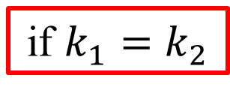
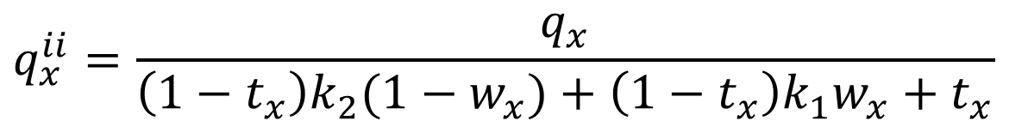
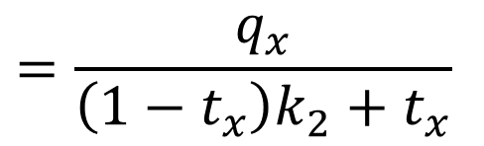
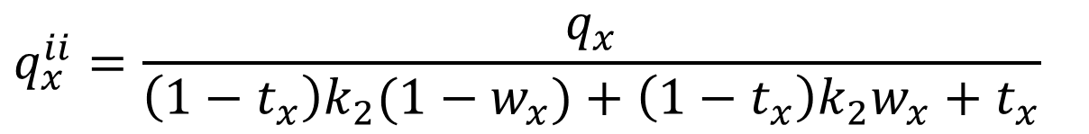
Survival and Transition Probabilities
$$q_{x}^{ii}=\frac{q_{x}}{\left(1−t_{x}\right)k_{2}(1−w_{x})+\left(1−t_{x}\right)k_{1}w_{x}+t_{x}}$$
if $k_{1}=k_{2}$
$$q_{x}^{ii}=\frac{q_{x}}{\left(1−t_{x}\right)k_{2}(1−w_{x})+\left(1−t_{x}\right)k_{2}w_{x}+t_{x}}$$
$$=\frac{q_{x}}{\left(1−t_{x}\right)k_{2}+t_{x}}$$

Slide 16
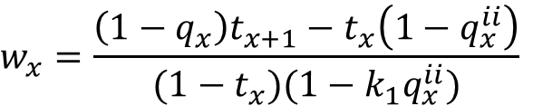
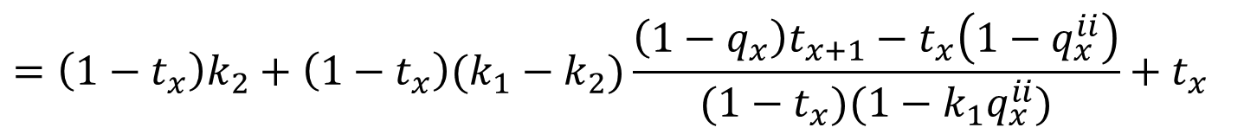

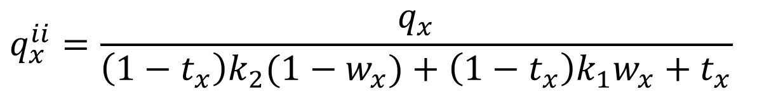

Survival and Transition Probabilities
if $k_{1}≠k_{2}$
$$w_{x}=\frac{\left(1−q_{x}\right)t_{x+1}−t_{x}\left(1−q_{x}^{ii}\right)}{(1−t_{x})(1−k_{1}q_{x}^{ii})}$$
$$q_{x}^{ii}=\frac{q_{x}}{\left(1−t_{x}\right)k_{2}(1−w_{x})+\left(1−t_{x}\right)k_{1}w_{x}+t_{x}}$$
代入
分母：
$$\left(1−t_{x}\right)k_{2}(1−w_{x})+\left(1−t_{x}\right)k_{1}w_{x}+t_{x}$$
$$=\left(1−t_{x}\right)k_{2}+\left(1−t_{x}\right)(k_{1}−k_{2})w_{x}+t_{x}$$
$$=\left(1−t_{x}\right)k_{2}+\left(1−t_{x}\right)(k_{1}−k_{2})\frac{\left(1−q_{x}\right)t_{x+1}−t_{x}\left(1−q_{x}^{ii}\right)}{(1−t_{x})(1−k_{1}q_{x}^{ii})}+t_{x}$$
$$=\frac{\left(1−t_{x}\right)k_{2}(1−k_{1}q_{x}^{ii})+(k_{1}−k_{2})[\left(1−q_{x}\right)t_{x+1}−t_{x}\left(1−q_{x}^{ii}\right)]+t_{x}(1−k_{1}q_{x}^{ii})}{(1−k_{1}q_{x}^{ii})}$$
B
A
B
$$×q_{x}^{ii}=q_{x}×$$
A

Slide 17




Survival and Transition Probabilities
$$\{\left(1−t_{x}\right)k_{2}(1−k_{1}q_{x}^{ii})+(k_{1}−k_{2})[\left(1−q_{x}\right)t_{x+1}−t_{x}\left(1−q_{x}^{ii}\right)]+t_{x}(1−k_{1}q_{x}^{ii})\}q_{x}^{ii}=(1−k_{1}q_{x}^{ii})q_{x}$$
${(q_{x}^{ii})}^{2}$
$$−\left(1−t_{x}\right)k_{2}k_{1}+\left(k_{1}−k_{2}\right)t_{x}−t_{x}k_{1}=k_{1}k_{2}t_{x}−k_{1}k_{2}+k_{1}t_{x}−k_{2}t_{x}−k_{1}t_{x}$$
$$=k_{1}k_{2}t_{x}−k_{1}k_{2}−k_{2}t_{x}=k_{2}\left[k_{1}t_{x}−k_{1}−t_{x}\right]=−k_{2}\left[{−k}_{1}t_{x}+k_{1}+t_{x}\right]$$
$$=−k_{2}\left[k_{1}\left(1−t_{x}\right)+t_{x}\right]$$
$q_{x}^{ii}$
$$\left(1−t_{x}\right)k_{2}+\left(k_{1}−k_{2}\right)\left[\left(1−q_{x}\right)t_{x+1}−t_{x}\right]+t_{x}+k_{1}q_{x}$$
$$=k_{2}−k_{2}t_{x}+\left(k_{1}−k_{2}\right)\left(1−q_{x}\right)t_{x+1}−k_{1}t_{x}+k_{2}t_{x}+t_{x}+k_{1}q_{x}$$
$$=\left(k_{1}−k_{2}\right)\left(1−q_{x}\right)t_{x+1}+k_{1}(q_{x}−t_{x})+k_{2}+t_{x}$$
常數
$$−q_{x}$$
$$−k_{2}\left[k_{1}\left(1−t_{x}\right)+t_{x}\right]{\left(q_{x}^{ii}\right)}^{2}+\left[\left(k_{1}−k_{2}\right)\left(1−q_{x}\right)t_{x+1}+k_{1}\left(q_{x}−t_{x}\right)+k_{2}+t_{x}\right]q_{x}^{ii}−q_{x}=0$$

Slide 18

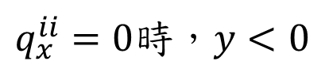

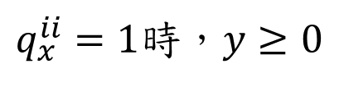


Survival and Transition Probabilities
a
b
c
$$−k_{2}\left[k_{1}\left(1−t_{x}\right)+t_{x}\right]{\left(q_{x}^{ii}\right)}^{2}+\left[\left(k_{1}−k_{2}\right)\left(1−q_{x}\right)t_{x+1}+k_{1}\left(q_{x}−t_{x}\right)+k_{2}+t_{x}\right]q_{x}^{ii}−q_{x}=0$$
解一元二次 求$q_{x}^{ii}$估計值
$q_{x}^{ii}$必須落在(0,1)區間
也就是說在解一元二次時，只能有一個根落在0~1之間
其中
$$y=a{(q_{x}^{ii})}^{2}+bq_{x}^{ii}+c$$
滿足以下條件：
1
$q_{x}^{ii}=0$時，$y<0$
2
$y$為極值時，也就是$y^{′}=2aq_{x}^{ii}+b=0\overset{⇒}{}q_{x}^{ii}=\frac{−b}{2a}$時
又$a=−k_{2}\left[k_{1}\left(1−t_{x}\right)+t_{x}\right]<0 ∵0<t_{x}<1$
$y$為極大值時，$q_{x}^{ii}$要大於0
3
$q_{x}^{ii}=1$時，$y≥0$

Slide 19
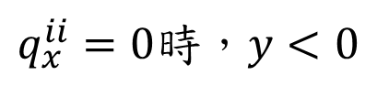

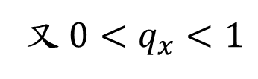
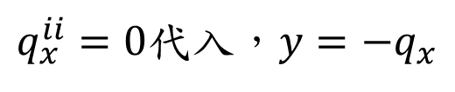
Survival and Transition Probabilities
$$y=−k_{2}\left[k_{1}\left(1−t_{x}\right)+t_{x}\right]{\left(q_{x}^{ii}\right)}^{2}+\left[\left(k_{1}−k_{2}\right)\left(1−q_{x}\right)t_{x+1}+k_{1}\left(q_{x}−t_{x}\right)+k_{2}+t_{x}\right]q_{x}^{ii}−q_{x}$$
1
$q_{x}^{ii}=0$時，$y<0$
$q_{x}^{ii}=0$代入，$y=−q_{x}$
又 $0<q_{x}<1$
所以$y=−q_{x}<0$
第一點滿足

Slide 20
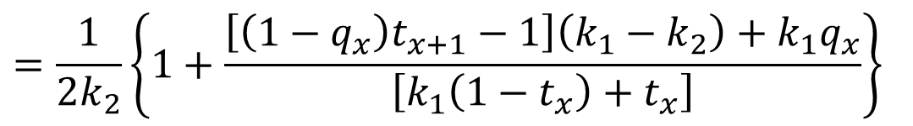
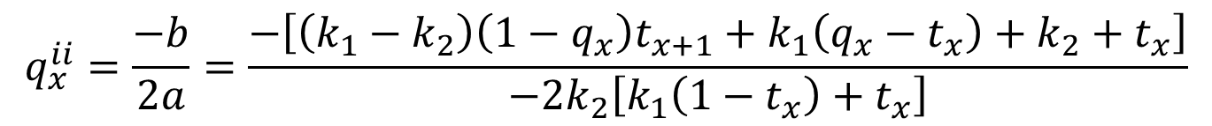

Survival and Transition Probabilities
$$y=−k_{2}\left[k_{1}\left(1−t_{x}\right)+t_{x}\right]{\left(q_{x}^{ii}\right)}^{2}+\left[\left(k_{1}−k_{2}\right)\left(1−q_{x}\right)t_{x+1}+k_{1}\left(q_{x}−t_{x}\right)+k_{2}+t_{x}\right]q_{x}^{ii}−q_{x}$$
2
$y$為極值時，也就是$y^{′}=2aq_{x}^{ii}+b=0\overset{⇒}{}q_{x}^{ii}=\frac{−b}{2a}$時
又$a=−k_{2}\left[k_{1}\left(1−t_{x}\right)+t_{x}\right]<0 ∵0<t_{x}<1$
$y$為極大值時，要$q_{x}^{ii}$大於0
$$q_{x}^{ii}=\frac{−b}{2a}=\frac{−\left[\left(k_{1}−k_{2}\right)\left(1−q_{x}\right)t_{x+1}+k_{1}\left(q_{x}−t_{x}\right)+k_{2}+t_{x}\right]}{−2k_{2}\left[k_{1}\left(1−t_{x}\right)+t_{x}\right]}$$
$$=\frac{1}{2k_{2}}\left\{1+\frac{\left[\left(1−q_{x}\right)t_{x+1}−1\right]\left(k_{1}−k_{2}\right)+k_{1}q_{x}}{\left[k_{1}\left(1−t_{x}\right)+t_{x}\right]}\right\}$$
分2個case討論

Slide 21
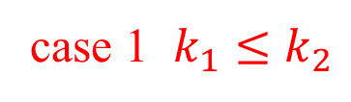

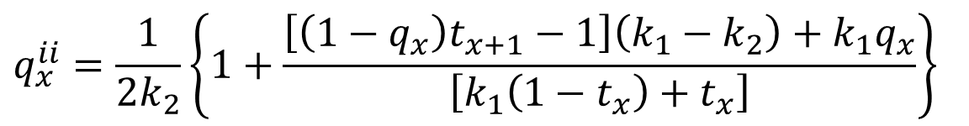
Survival and Transition Probabilities
$$y=−k_{2}\left[k_{1}\left(1−t_{x}\right)+t_{x}\right]{\left(q_{x}^{ii}\right)}^{2}+\left[\left(k_{1}−k_{2}\right)\left(1−q_{x}\right)t_{x+1}+k_{1}\left(q_{x}−t_{x}\right)+k_{2}+t_{x}\right]q_{x}^{ii}−q_{x}$$
case 1 $k_{1}≤k_{2}$
-
-
+
$$q_{x}^{ii}=\frac{1}{2k_{2}}\left\{1+\frac{\left[\left(1−q_{x}\right)t_{x+1}−1\right]\left(k_{1}−k_{2}\right)+k_{1}q_{x}}{\left[k_{1}\left(1−t_{x}\right)+t_{x}\right]}\right\}$$
$$>0$$
+
+
第二點滿足

Slide 22

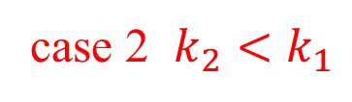
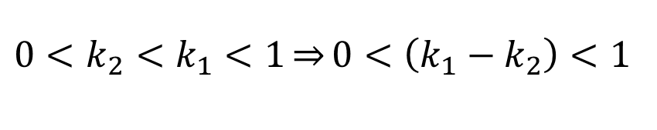
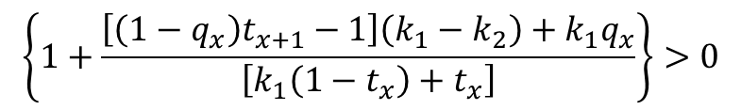


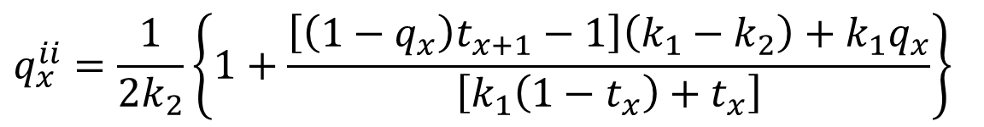
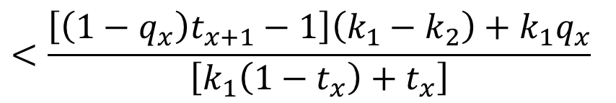
Survival and Transition Probabilities
$$y=−k_{2}\left[k_{1}\left(1−t_{x}\right)+t_{x}\right]{\left(q_{x}^{ii}\right)}^{2}+\left[\left(k_{1}−k_{2}\right)\left(1−q_{x}\right)t_{x+1}+k_{1}\left(q_{x}−t_{x}\right)+k_{2}+t_{x}\right]q_{x}^{ii}−q_{x}$$
case 2 $k_{2}<k_{1}$
$$0<k_{2}<k_{1}<1\overset{⇒}{}0<\left(k_{1}−k_{2}\right)<1$$
+c
+
$$−1<−\left(k_{1}−k_{2}\right)<−\left(k_{1}−k_{2}\right)+\left(1−q_{x}\right)t_{x+1}\left(k_{1}−k_{2}\right)+k_{1}q_{x}$$
$$=\left[\left(1−q_{x}\right)t_{x+1}−1\right]\left(k_{1}−k_{2}\right)+k_{1}q_{x}$$
$$<\frac{\left[\left(1−q_{x}\right)t_{x+1}−1\right]\left(k_{1}−k_{2}\right)+k_{1}q_{x}}{\left[k_{1}\left(1−t_{x}\right)+t_{x}\right]}$$
則
$$\left\{1+\frac{\left[\left(1−q_{x}\right)t_{x+1}−1\right]\left(k_{1}−k_{2}\right)+k_{1}q_{x}}{\left[k_{1}\left(1−t_{x}\right)+t_{x}\right]}\right\}>0$$
$$0<\left[k_{1}\left(1−t_{x}\right)+t_{x}\right]<1$$
$$q_{x}^{ii}=\frac{1}{2k_{2}}\left\{1+\frac{\left[\left(1−q_{x}\right)t_{x+1}−1\right]\left(k_{1}−k_{2}\right)+k_{1}q_{x}}{\left[k_{1}\left(1−t_{x}\right)+t_{x}\right]}\right\}$$
$$>0$$
第二點滿足

Slide 23
Survival and Transition Probabilities
$$y=−k_{2}\left[k_{1}\left(1−t_{x}\right)+t_{x}\right]{\left(q_{x}^{ii}\right)}^{2}+\left[\left(k_{1}−k_{2}\right)\left(1−q_{x}\right)t_{x+1}+k_{1}\left(q_{x}−t_{x}\right)+k_{2}+t_{x}\right]q_{x}^{ii}−q_{x}$$
2
$y$為極值時，也就是$y^{′}=2aq_{x}^{ii}+b=0\overset{⇒}{}q_{x}^{ii}=\frac{−b}{2a}$時
又$a=−k_{2}\left[k_{1}\left(1−t_{x}\right)+t_{x}\right]<0 ∵0<t_{x}<1$
$y$為極大值時，要$q_{x}^{ii}$大於0
$$q_{x}^{ii}=\frac{−b}{2a}=\frac{−\left[\left(k_{1}−k_{2}\right)\left(1−q_{x}\right)t_{x+1}+k_{1}\left(q_{x}−t_{x}\right)+k_{2}+t_{x}\right]}{−2k_{2}\left[k_{1}\left(1−t_{x}\right)+t_{x}\right]}$$
$$=\frac{1}{2k_{2}}\left\{1+\frac{\left[\left(1−q_{x}\right)t_{x+1}−1\right]\left(k_{1}−k_{2}\right)+k_{1}q_{x}}{\left[k_{1}\left(1−t_{x}\right)+t_{x}\right]}\right\}$$
2個case都可以得到第二點成立

Slide 24

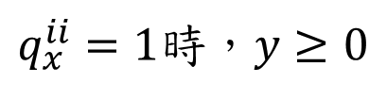


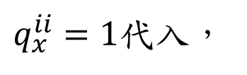
Survival and Transition Probabilities
$$y=−k_{2}\left[k_{1}\left(1−t_{x}\right)+t_{x}\right]{\left(q_{x}^{ii}\right)}^{2}+\left[\left(k_{1}−k_{2}\right)\left(1−q_{x}\right)t_{x+1}+k_{1}\left(q_{x}−t_{x}\right)+k_{2}+t_{x}\right]q_{x}^{ii}−q_{x}$$
3
$q_{x}^{ii}=1$時，$y≥0$
$q_{x}^{ii}=1$代入，
$$y=−k_{2}\left[k_{1}\left(1−t_{x}\right)+t_{x}\right]+\left[\left(k_{1}−k_{2}\right)\left(1−q_{x}\right)t_{x+1}+k_{1}\left(q_{x}−t_{x}\right)+k_{2}+t_{x}\right]−q_{x}$$
$$=k_{2}\left\{1−\left[k_{1}\left(1−t_{x}\right)+t_{x}\right]\right\}+\left(k_{1}−k_{2}\right)\left(1−q_{x}\right)t_{x+1}+\left(1−k_{1}\right)\left(t_{x}−q_{x}\right)$$
假設 $k_{2}<k_{1}$
$$t_{x}>q_{x}$$
$$>0$$
$$y=k_{2}\left\{1−\left[k_{1}\left(1−t_{x}\right)+t_{x}\right]\right\}+\left(k_{1}−k_{2}\right)\left(1−q_{x}\right)t_{x+1}+\left(1−k_{1}\right)\left(t_{x}−q_{x}\right)$$
+
+
+
第三點滿足

Slide 25

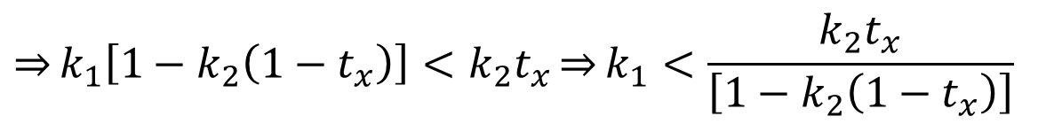

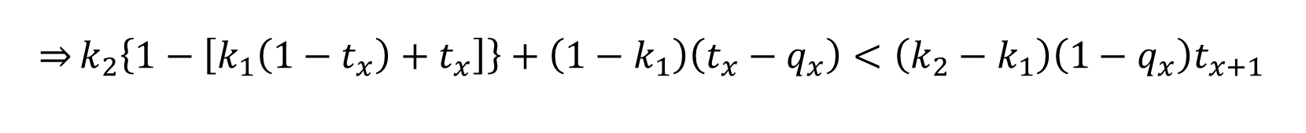
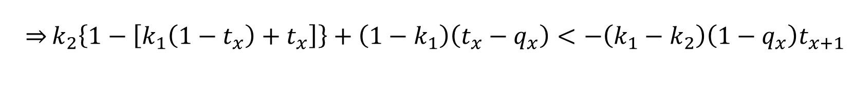



Survival and Transition Probabilities
$$y=k_{2}\left\{1−\left[k_{1}\left(1−t_{x}\right)+t_{x}\right]\right\}+\left(k_{1}−k_{2}\right)\left(1−q_{x}\right)t_{x+1}+\left(1−k_{1}\right)\left(t_{x}−q_{x}\right)$$
假設非 $k_{2}<k_{1}$ 怎樣情況 $y<0$ 會發生
$$t_{x}>q_{x}$$
令 $y=k_{2}\left\{1−\left[k_{1}\left(1−t_{x}\right)+t_{x}\right]\right\}+\left(k_{1}−k_{2}\right)\left(1−q_{x}\right)t_{x+1}+\left(1−k_{1}\right)\left(t_{x}−q_{x}\right)<0$
$\overset{⇒}{}k_{2}\left\{1−\left[k_{1}\left(1−t_{x}\right)+t_{x}\right]\right\}+\left(1−k_{1}\right)\left(t_{x}−q_{x}\right)<−\left(k_{1}−k_{2}\right)\left(1−q_{x}\right)t_{x+1}$
$\overset{⇒}{}k_{2}\left\{1−\left[k_{1}\left(1−t_{x}\right)+t_{x}\right]\right\}+\left(1−k_{1}\right)\left(t_{x}−q_{x}\right)<\left(k_{2}−k_{1}\right)\left(1−q_{x}\right)t_{x+1}$
$$\left(k_{2}−k_{1}\right)\left(1−q_{x}\right)t_{x+1}<\left(k_{2}−k_{1}\right)$$
$$∵0<\left(1−q_{x}\right)<1 , 0<t_{x+1}<1$$
$k_{2}\left\{1−\left[k_{1}\left(1−t_{x}\right)+t_{x}\right]\right\}+\left(1−k_{1}\right)\left(t_{x}−q_{x}\right)>$ $k_{2}\left\{1−\left[k_{1}\left(1−t_{x}\right)+t_{x}\right]\right\}$
$$∵\left(1−k_{1}\right)\left(t_{x}−q_{x}\right)>0$$
$$k_{2}\left\{1−\left[k_{1}\left(1−t_{x}\right)+t_{x}\right]\right\}<\left(k_{2}−k_{1}\right)\underset{⇒}{}−\left[k_{1}k_{2}\left(1−t_{x}\right)+k_{2}t_{x}\right]<−k_{1}$$
$$\underset{⇒}{}k_{1}\left[1−k_{2}\left(1−t_{x}\right)\right]<k_{2}t_{x}\underset{⇒}{}k_{1}<\frac{k_{2}t_{x}}{\left[1−k_{2}\left(1−t_{x}\right)\right]}$$

Slide 26
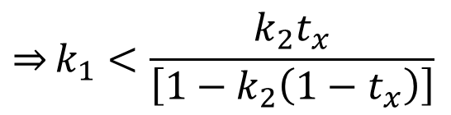
Survival and Transition Probabilities
$$y=k_{2}\left\{1−\left[k_{1}\left(1−t_{x}\right)+t_{x}\right]\right\}+\left(k_{1}−k_{2}\right)\left(1−q_{x}\right)t_{x+1}+\left(1−k_{1}\right)\left(t_{x}−q_{x}\right)$$
假設非 $k_{2}<k_{1}$ 怎樣情況 $y<0$ 會發生
$$t_{x}>q_{x}$$
$$\underset{⇒}{}k_{1}<\frac{k_{2}t_{x}}{\left[1−k_{2}\left(1−t_{x}\right)\right]}$$
所以在$\frac{k_{2}t_{x}}{\left[1−k_{2}\left(1−t_{x}\right)\right]}<k_{1}<k_{2}<1$ ，$y>0$ 會發生
第三點滿足

Slide 27
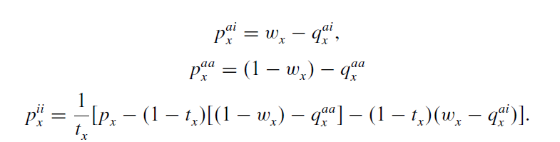

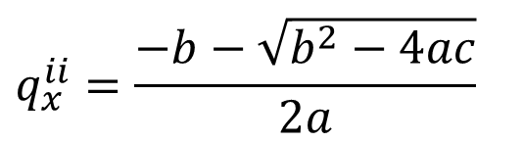

Survival and Transition Probabilities
因為函數$y$的樣子符合以上3點所以
a
b
c
$$−k_{2}\left[k_{1}\left(1−t_{x}\right)+t_{x}\right]{\left(q_{x}^{ii}\right)}^{2}+\left[\left(k_{1}−k_{2}\right)\left(1−q_{x}\right)t_{x+1}+k_{1}\left(q_{x}−t_{x}\right)+k_{2}+t_{x}\right]q_{x}^{ii}−q_{x}=0$$
解一元二次 求$q_{x}^{ii}$估計值為
$$q_{x}^{ii}=\frac{−b−\sqrt{b^{2}−4ac}}{2a}$$
假設1
假設2

